Slide 1
Managerial Economics and
Organizational Architecture Chapter 16:
Individual Performance Evaluation

Slide 2
Performance Evaluation
Læs Lincoln Electric! Essentiel case, p. 498 – 500ø.
Evaluations provide employees feedback on achievement and ways to improve
Evaluations are used to determine rewards and sanctions (kap. 16)
Evaluations regard evaluating employees as well as subunits of the firm (kap. 17).
2

Slide 3

Hvorfor præstationsmåle?
For at give medarbejdere feedback
Medvirker til at løse koordinationsproblemet!
For at bestemme belønninger (‘rewards’) og sanktioner
Medvirker til at løse motivationsproblemet!
Præstationsmålinger er en central del af virksomhedens organisatoriske arkitektur (se også kap. 17)
Præstationsmålinger skal afspejle belønningssystemet
Præstationsmålinger skal afspejle uddelegering af beslutningsrettigheder
Organisatoriske arkitektur
Beslutningsrettigheder
Præstationsmålinger
Kompensation

Slide 4
Nedslagspunkter i dag
Præstationsmåling
Relative præstationsmålinger
Absolutte præstationsmålinger
Objektive præstationsmålinger
Subjektive præstationsmålinger
Kombinationer af måltyper
Problemer/udfordringer ved forskellige typer af præstationsmålinger
Måleomkostninger og ‘informativeness’-princippet

Slide 5
Incentive Compensation (again)
Principal-agent model
Employee output: Q = αe + μ ⇒
objective performance measure
Compensation: W = W₀ + βQ ⇒
compensating differential
α = MP!
Kompensation for at bære risiko
’Præstationslønselasticitet’/
incitamentkoefficienten

Slide 6
Implicit Assumptions
Principal knows agent’s production function
Output is a single quantitative measure of performance
Employee produces a single output
Output can be observed at zero (or low) cost
Employee cannot game the measure
Mutually beneficial contract is feasible
Labour market is unregulated
Employee works independently

Slide 7
Setting Performance Benchmarks
If management has no knowledge on a) effort and production or on b) average employee effort?
Make time and motion studies
‘Engineers’ estimate the amount of time a task requires
Determines most effective work method
Past performance and ‘ratchet system’ (def.):
“…refers to basing next periods standard of performance on this periods actual performance” (BSZ (TV) p. 502n.).
Ratchet effect; employees have incentives to only meet the goal and not exceed it/withhold performance
Ramme 502n. – 503n.!
‘Sandbagging’

Slide 8
Measurement Costs
Everything costs! (ramme p. 504).
Accounting system(s) may need to be developed.
The value-maximizing firm should improve measures as long as incremental benefits justify costs (se næste planche).
If employee compensation incentive is to be increased, at the same time increase the precision with which effort is measured!
=>

Slide 9
Informativeness Principle (p. 505)
Def.:
“The Informativeness Principle implies that whenever low-cost information is available that allows a more accurate assessment of the employee’s effort, such information should be used in assessing performance”!
“A value-maximizing firm will go to the point where the incremental cost of increasing the precision of its performance measurement (through more sophisticated accounting and information systems, for instance) equals the incremental benefits. These benefits include the reduction in the risk premium that must be payed to employees.”!

Slide 10
Informativeness Principle (igen, se p. 505)
Use all appropriate information when evaluating performance.
Consider uncontrollable factors – ex. market conditions
Select benchmarks to support relative performance measurement (uddybes snart)
By measuring employee effort with more precision, effort choice will be more efficient.

Slide 11
Opportunism
Gaming
Employees may engage in dysfunctional activities to improve their evaluations
Jvf. tidligere eksempler samt 507m. – n.!
Horizon problem
Short-run objective performance measure may cause employees to focus on results that influence their evaluation only over their remaining time with the firm!
11

Slide 12
Kompensationsplan koblet til et Balanced Scorecard, eller; hvordan man undgår opportunisme i et Balanced Scorecard
Kategori | Mål | Vægtning | Bund-og maksimalniveau
Finansielt (60%). | 1. EVA. 2. Afkastningsgrad i forhold til konkurrenter. 3. Markedsvækst. | 30% 20% 10% | 1.000.000. 0 - 10% mere end gennemsnittet. 5 - 10%.
Kundeperspektiv (20%). | 4. Markedsandel. 5. Kundetilfredshed. | 10% 10% | 5% 85 - 95% tilfredse eller meget tilfredse.
Interne perspektiv (10%). | 6. Kvalitetsfejl.. 7. Effektivitet (enhedsomkostninger). | 5% 5% | 95 - 98% fejlfrie 2% i forhold til sidste år.
Læring (10%). | 8. Medarbejdertilfredshed. 9. Efteruddannelse. | 5% 5% | 90% tilfredse eller meget tilfredse. 10 – 15 arbejdsdage.
Friis & Vámosi 2005
12

Slide 13
Opportunisme og Horisontproblemet
 | År 1 | År 2 | År 3
EVA (et profitmål) | 10.000 | 20.000 | -30.000
Optjent bonus (10% af EVA) | 1.000 | 2.000 | -3.000
Bonusbank | 1.000 | 3.000 | 0
Friis & Vámosi 2005

Slide 14
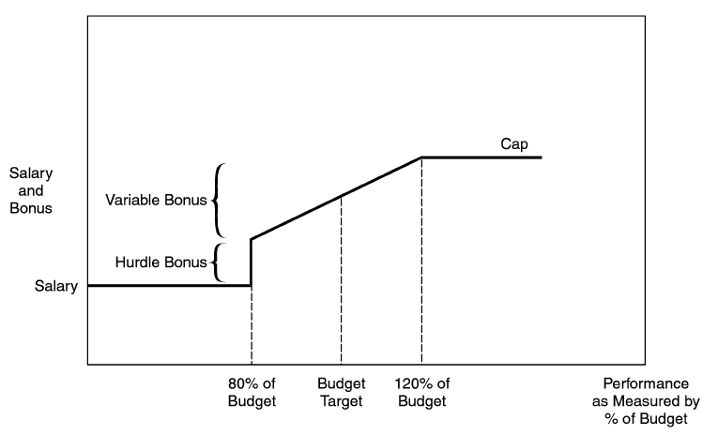
Traditionel præstationsaflønning
Jensen 2003

Slide 15
Løsningen!?
Problemet ifølge Jensen 2003 er IKKE budgettering i sig selv – men koblingen af denne til bonus!
Gør en evt. bonus (eller forfremmelse!) til en funktion af hvad medarbejderen/lederen faktisk ’når’/præsterer – ikke af targets og budgetter. Hermed elimineres incitamentet for gaming (Jensen 2003). Er alt så løst?
Lineær pay-for-performance – men dette overflødiggør ikke i sig selv behovet for et kontrolsystem!

Slide 16
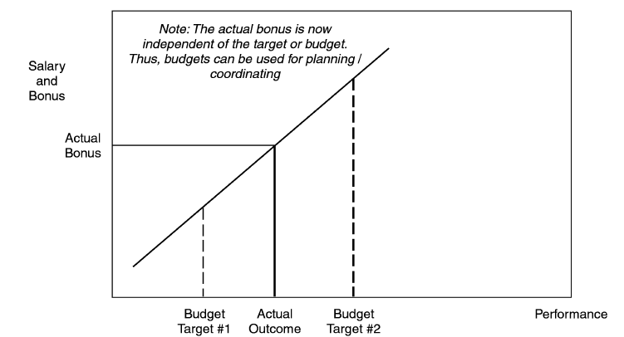
Lineært system
Jensen 2003

Slide 17
Relative Performance Evaluation
Evaluate worker output relative to their co-workers in the same job
Problems within the firm:
jobs are not always identical
group has incentive to punish ‘rate busters’
incentive to hire less competent workers
Problems across firms:
data hard to obtain
17

Slide 18
Subjective Performance Evaluation
Firms often use subjective (more ‘holistic’, aggregated) evaluation along with objective measures
Perfect measures are expensive
Relative weights may change
Multiple tasks and unbalanced effort
Workers have incentives to concentrate on activities that are easily measured
“You get what you measure” (Kaplan & Norton, 1992)! And only that?
The subjective measure will allow the supervisor to determine cooperation and other ‘difficult to measure’ activities (ex. training new staff)
Ramme 511n.!!! Og =>
18

Slide 19
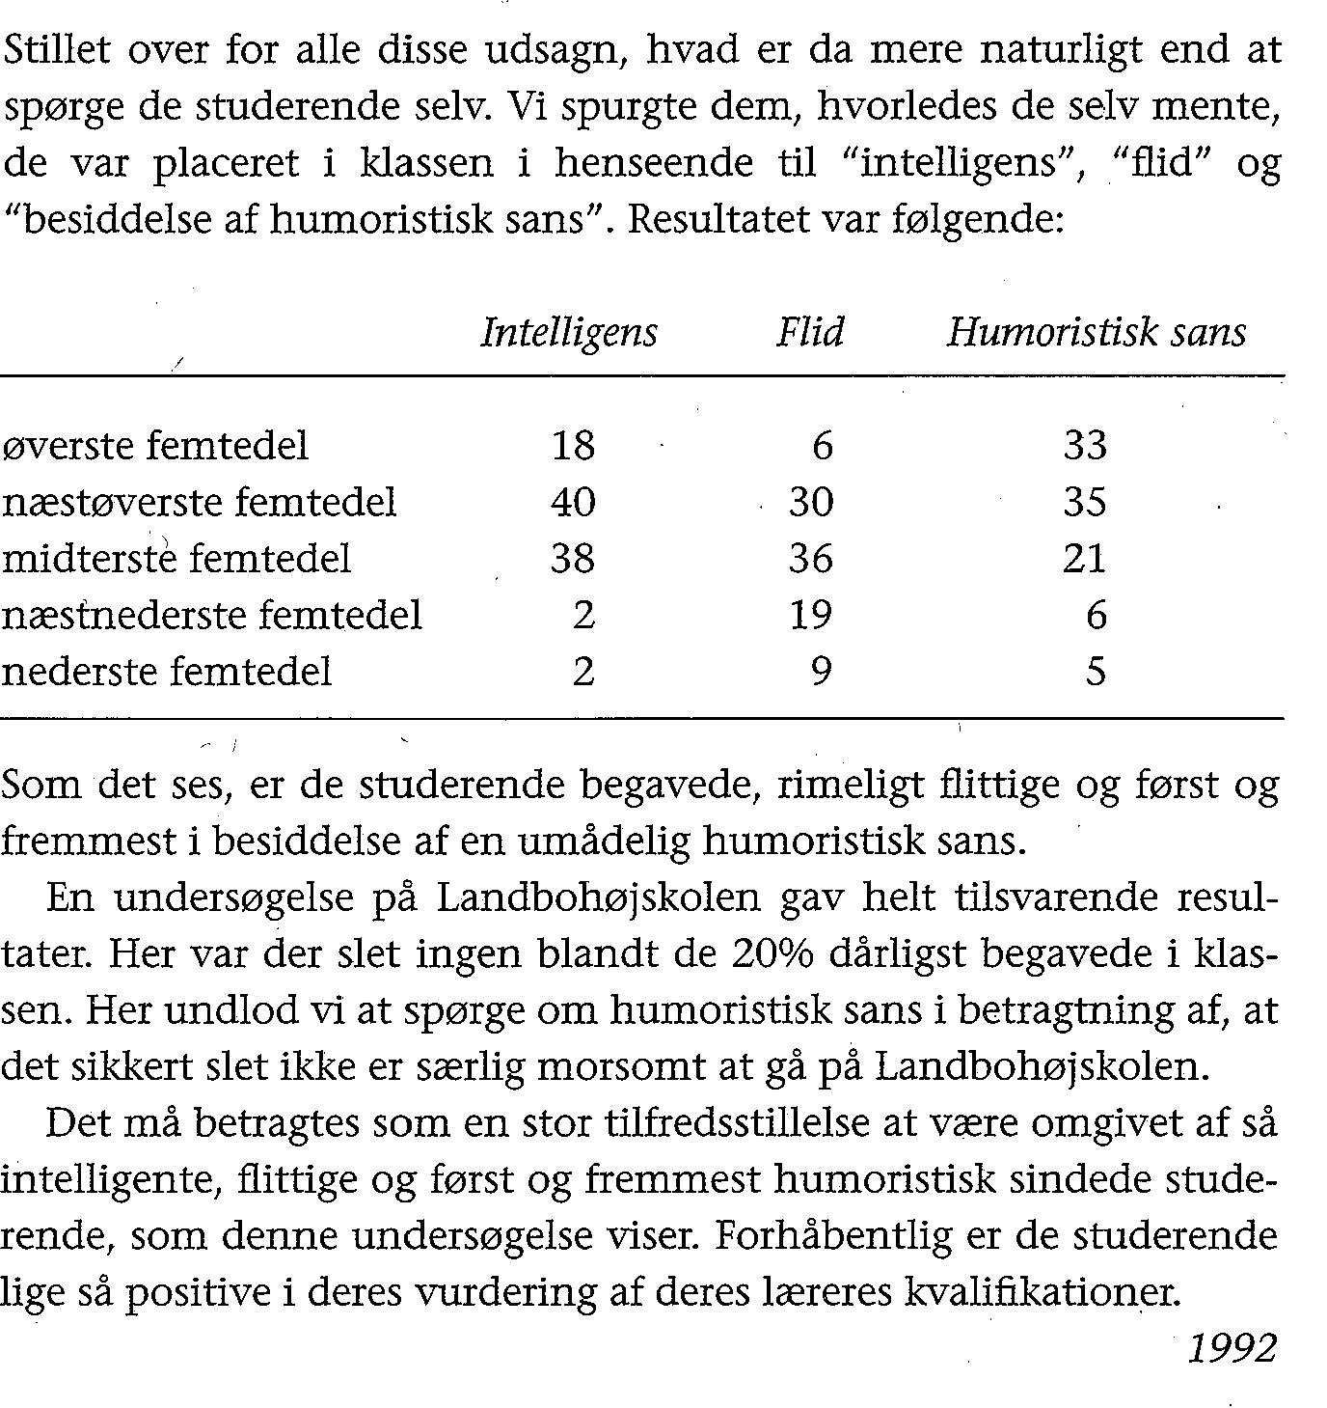
Self evaluation
19
Nielsen & Møller 1993

Slide 20
Subjective Evaluation Methods
Standard rating scales
Rank (ex. in 5 levels) employees on various performance factors (eksempler, ramme 512n. – 513ø.)
Goal-based systems (more explicit, less subjective than..)
Set annual goals and then measure whether the employee achieve these or not
Bemærk ‘peer evaluation’ og problemer hermed (‘ligestillede’, venner?, konkurrenter?, 514ø.)
Frequency
Often more frequent reviews are too costly

Slide 21
Problems with Subjective Evaluations
Supervisor shirking
f.eks. grundet modvilje (‘pain avoidance’, M. Jensen)
upræcise vurderinger – for gode, for dårlige af ‘organisatoriske grunde’
bemærk ex. p. 515.
fokusér på evaluatorernes incitamenter
stil disse til ansvar for evalueringerne
Forced distribution
‘Normal-/standardfordeling’
May result in good employees being evaluated poorly and vice versa – where is the ‘truth’/the ‘true’ evaluation?
Influence costs
21

Slide 22
Combining Performance Measures
Few job performance measures are purely objective or subjective
Both types can be inaccurate
increasing inaccuracy of either places greater weight on the other
inaccuracies increase employee risk and compensating differential
Both can induce dysfunctional behaviors
Ramme 518n.! Eller ‘hvad er det mindst ringe?’
22

Slide 23
Team Performance
Team production
Individual output: Q_{i} = 5e + μ
Team output: Q_{t} = 4e² + μ
10e = 4e²
^{=> 10 = 4e =>} ^{e = 2,5}
Team evaluation
Peer evaluations to alleviate free-rider problems
Ramme 521n. – 5225m.! – teams in Business School courses (repetition, repeated games?)
Hvornår er 4e² > 5e + 5e?
23

Slide 24
Comparing Individual and Team Output
Q
Conrad and Dina’s team output
Sum of Conrad’s and Dina’s individual outputs
Expected output
25
e
2.5
Conrad’s and Dina’s individual effort levels
24

Slide 25
Definitioner/karakteristika ved præstationsmålinger
1. Præstationsmåling:
En procedure/måde/metode at måle en medarbejders/afdelings arbejdsindsats eller output i forhold til i forvejen specificerede arbejdsopgaver (TV).
2. Relative præstationsmålinger:
“Using the output of other employees to adjust the employees' output in the compensation contract” (BSZ p. 314).
3. Absolutte præstationsmålinger:
“Når en målingsdimension er fast forankret i den enkelte medarbejders (eller teams’ eller afdelings) og kun dennes præstation og dermed ikke bliver sammenlignet med andre medarbejdere (teams/afdelinger)” (tilpasset Hansen (2009/2010)).
4. Objektive præstationsmålinger:
Når ”...produceren for principalens måling af agentens præstation er specificeret entydigt på forhånd (ex ante), og muligheden for verifikation af tredje part er tilstede” (Hansen 2009/2010).
5. Subjektive præstationsmålinger:
“Med en subjektiv måling forstås, at principalen subjektivt evaluerer agentens præstation, når perioden er omme (ex post)” (Hansen 2009/2010).

